Slide 1
Introduction
A quick breakdown about the creation of SADA Superstore

Slide 2
What we chose
Abdala
Requirements include:
Registration is needed to shop online
Must include loyalty scheme – Points system
Must include offers and promotions – Marketing
Stock must be updated based on scarce resource – Supplier interface
Must include funds and balance – Payment

Slide 3
Meet The Team
Akber – Project Manager / Supplier
Sabaa – Head Core Developer/ Analytics
Abdala - Marketing
David – Payment
Subodh – Loyalty Scheme

Slide 4
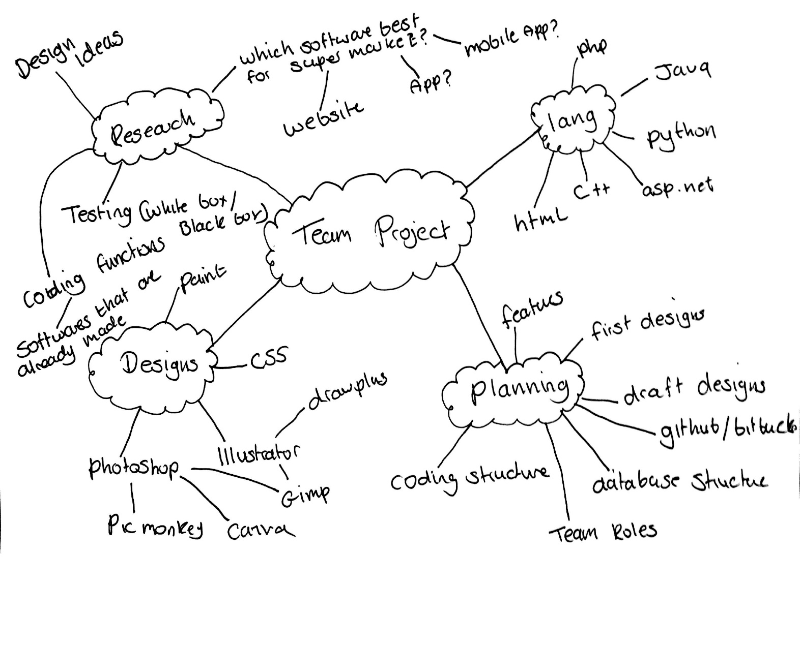
Planning
Sabba
The course of action we took towards the planning of the project was brain storming.
This was basic but effective as it encouraged group members to provide their ideas and perspective on the project.
Software Consists of: Html, CSS, PHP and MySQL.

Slide 5
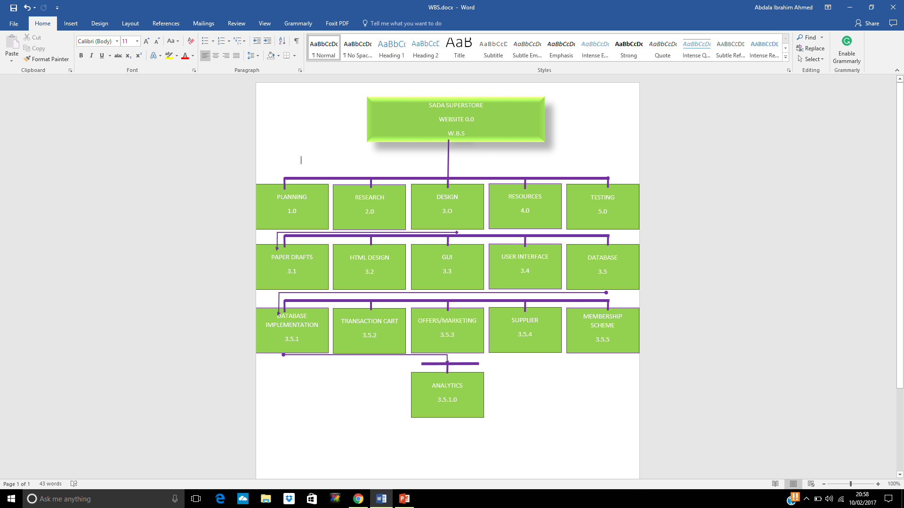
WBS (Work Breakdown Structure)
Akber

Slide 6
Head Core Developer / Analytics
Sabba
Head Core Developer
Website Structure
Database Structure
Quality Assurance
On-going Core Development (CMS)
Analytics – Study the data from the database to research about potential trends, this will help analyse the effects of certain decisions or events or to evaluate performance of the business or software.
The goal of analytics is to improve the business by gaining knowledge which can be used to make improvements or changes.

Slide 7
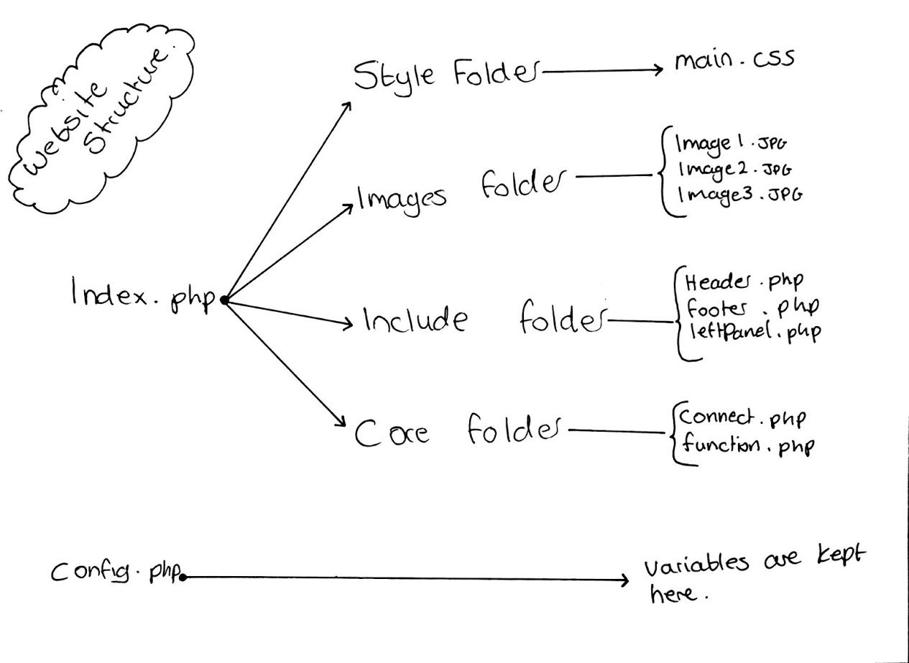

Slide 8
Database Structure
Sabba
Table names:
Account – User details stored here.
Cart - Products you have in the basket will be stored here.
News – latest news (promotions)
Products – all of the products that the supermarket sells will be stored here
Promotions – Different kind of promotions will be stored here.
Purchase_order – Checkout orders will be stored here.
Purchase_transactions – an extension to purchase_order, this table will store what products have being bought and how many. (receipt)
Stock – Stock for all products will be stored here.
Supplier – Supplier details will be stored here.

Slide 9
Sabba
Cart
Id User_id Cate Product_name Product_code Quantity S_price F_price Discounted
Supplier
Id Name Address Postcode Number
Account
Id Fname Sname Email Address Postcode Number Password Account_type Balance Points
News
Id Title Content Date Banner Account
Stock
Id Product_id Product_type Product_name Product_quantity supplier
Products
Id Name Cate Code Image Price
Purchase_transactions
Id Purchase_id Product_id Product_name S_price quantity
Purchase_order
Id User_id Price Date
Promotions
Id Desc Code Discount Cate

Slide 10
Project Manager
Akber
Overall responsibility for initiating, planning, design, execution, monitoring, controlling and finalising the project
The ability to ask penetrating questions
Chase up and confirm assumptions
Key roles – planning and setting up variables
Resourcing
Schedules
Managing issues
Leadership
Confidence and assurance

Slide 11
Supplier
Akber
Who is a supplier?
Manufacturer, distributor or a vendor
Can ship products to the supplier distribution hubs or directly to the retail store
Reliable and efficient
What is the role of a supplier?
Provide the products to resellers
The relationship between supplier and seller?
Is a very close relationship almost like a food chain between customer, seller and supplier
Responsibilities of a supplier?
Source the seller good products, material and supplier
What is EDI?
Electronic data integration – links databases, allows access between computer systems.
EDI is the best method and shows the trust between the supplier and seller
I am working on creating functions that will retrieve stock levels and update stock by requesting orders from the supplier.

Slide 12
Marketing
Abdala
Marketing is where a business creates new ways in which it can improve the performance of sales in hopes of increasing profit.
A business can do this by tracking consumer purchase, and by doing so can offer promotions and offers on popular products.
I approached this core by first researching the offers and promotions of other companies such as Tesco and Sainsbury for a better insight.
In doing so it has helped in deciding on offers and promotions that we will integrate into the software.

Slide 13
Marketing-Software :
Abdala
The promotions are advertised on the main page/home page
The customer will input the promo-code at checking out
The system checks with the database if the promotion Is available to them
If available another check is made to see if they meet the requirements for that specific promo.
If they meet the requirements the overall price is updated/discounted
Finally the customer pays and checks out with a discounted price.

Slide 14
Marketing: Tasks-to-do
Abdala
The promotions are limited – expand
Notifications alerting the customer on availability
Layout – in terms of visibility
Make design more user-friendly
Registration form needs changes based on the user interface.

Slide 15
Loyalty Scheme
Subodh
Loyalty Scheme is a rewards program offered by our company to those customers who frequently make purchases in our store. our loyalty scheme program gives our loyalty card holder customers extra points every time they make purchase in one of our stores. Loyalty card holders get five points for Every £1 they spent. These points can be redeemed to increase balance.
Research of php and mysql loyalty scheme integration
Altered table accounts to create points column
Gathering resources
Functions required:
create function to add point
create function to redeem the points to increase balance
Code to operate log in and log out functions
Testing

Slide 16
Payment
David
The main idea of Payment development plan: The customer can select a payment option Credit card or PayPal, then select the amount he/she wants to add and uses the money to purchase goods from the website
Research of Php payment integration
Research the payment options Credit card Or PayPal
Gathering resources, code snippets
Functions required:
Add_balance.php
Buy_product.php
Receipt.php
Testing of functions

Slide 17
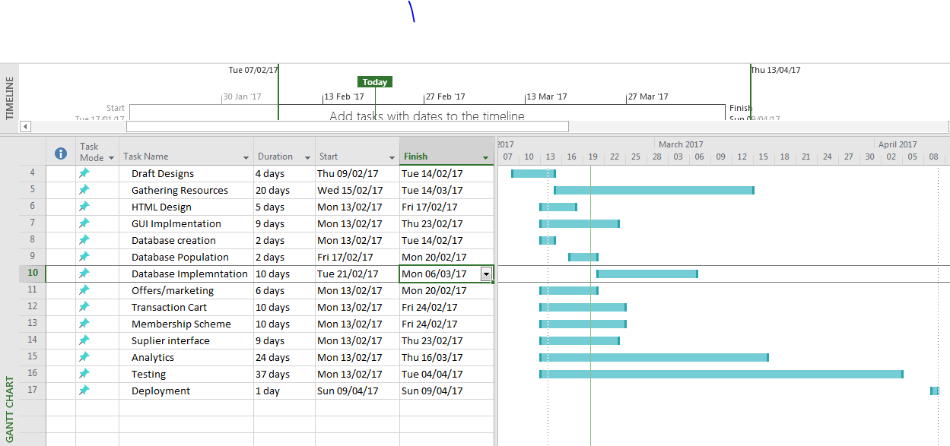
Gantt Chart
Akber

Slide 18
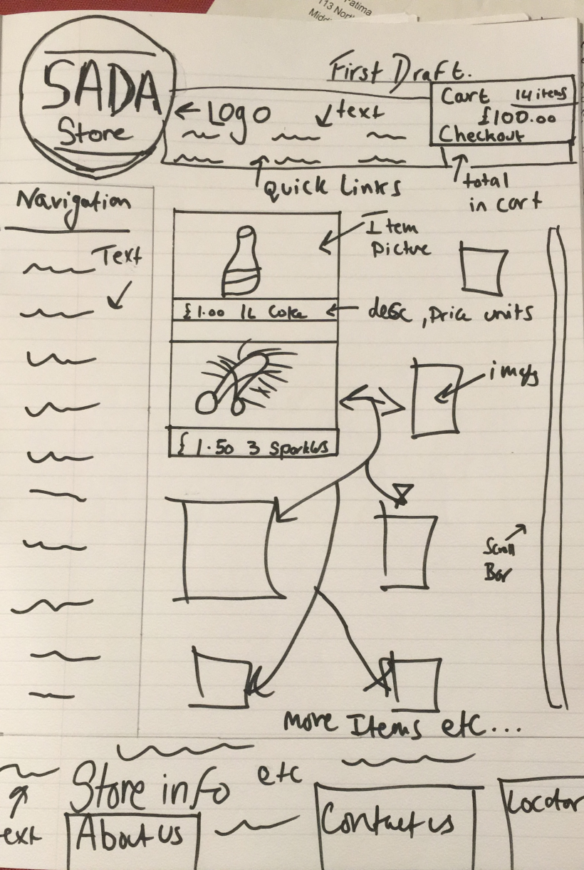
First Design
Akber

Slide 19
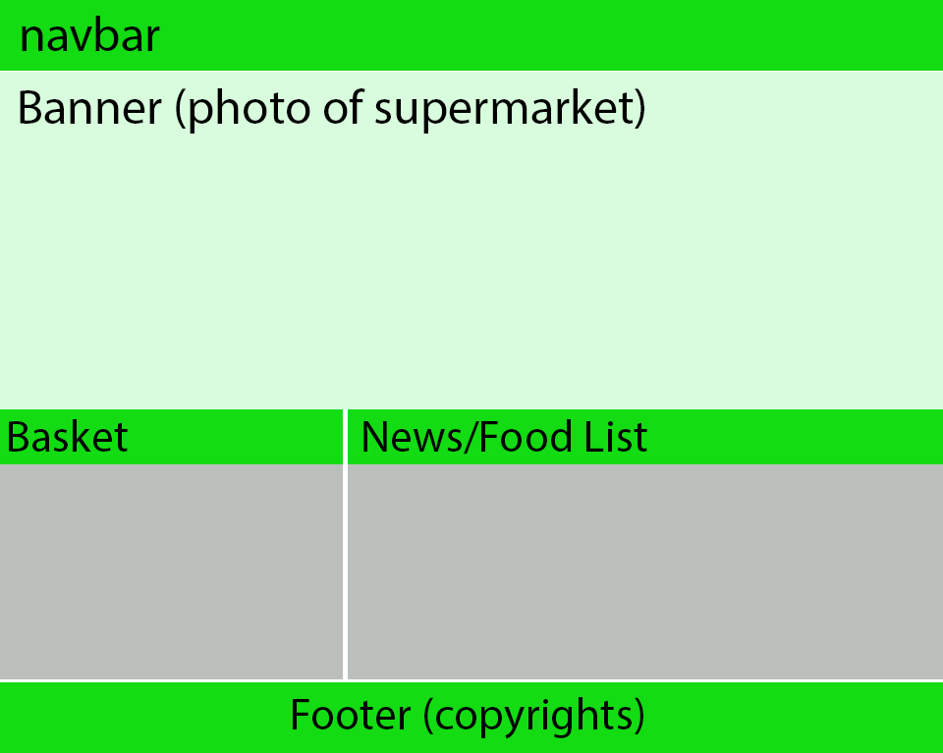
Draft Design
Sabba

Slide 20
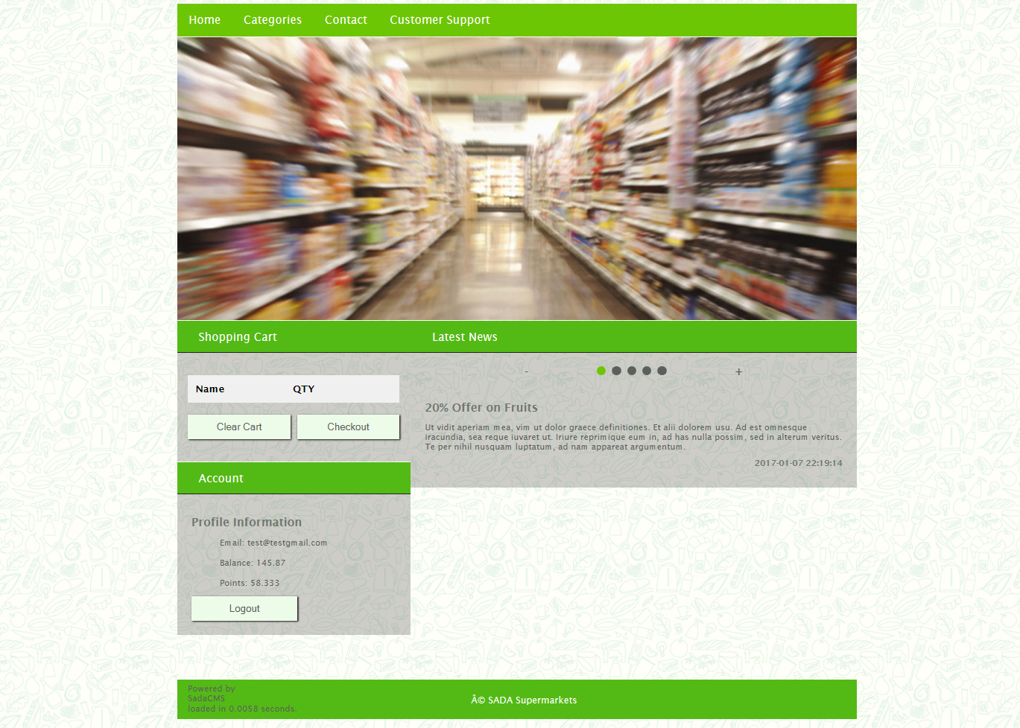
Sabba

Slide 21
Thank you for your time
Any Questions?

